Slide 1
Organized by
Event Producer

Slide 2
Opportunities in
INDIA
According to the World Economic Forum, India is now the world’s fastest growing large economy
India top three most attractive investment destinations
The Make in India initiative is to encourage global players to set up factories to cater locally as well as a manufacturing hub to the world.
HVAC systems are becoming one of the key building blocks in modern infrastructure
The manufacturing sector has the potential to grow six-fold by 2025 up to $ 1 trillion, creating 90 million jobs.
Digitization has given rise to the phenomenon of smart manufacturing, paving the way to Industry 4.0.
Growth Drivers - People, Process, Technology and Data

Slide 3
Ease of doing Business in
INDIA
India jumped 30 notches to the top 100 rankings on the World Bank’s ‘ease of doing business’ index in 2017
The World Bank states that India is one of the TOP 10 improvers and has implemented a significant reforms in taxation, construction permits, investor protection, etc..with the mantra of ‘Reform, Perform and Transform’
100% Foreign Direct Investment allowed in multi-brand retail of locally sourced processed food
To encourage investment, the Government of India is taking pro-active steps to improve ease of doing business:

Slide 4
Growth Drivers:
Demographics
Rising Middle Class Population - Income Levels of Emerging Middle Class
Improving National Council of Applied Economic Research (NCAER) Data - 53.3 Million Middle Class Households only 52% have AC’s

Slide 5
Growth Drivers:
Construction Industry
By 2025, Construction Market in India is expected to emerge as the third largest Globally
The construction industry in value terms is expected to record a CAGR of 15.5% to reach 738.5 bn by 2022
100 smart cities to be developed by 2020
5 Industrial Corridors planned
25 Railway stations Re-Development
6 Mega Ports planned
Increasing demand for commercial space : Construction of office spaces, hotels, retail, entertainment units
6 Mega ports planned

Slide 6
Growth Drivers: Construction Industry
With strong growth being witnessed in India’s construction market, demand for HVACs from major residential complexes, hotels, office spaces, amusement and recreation spaces is increasing, and this trend is anticipated to continue in the coming years.
Commercial construction sector is expected to emerge as the strongest performer, with institutional construction also anticipated to catch up some pace. Consequently, HVAC installations are expected to continue growing in the commercial segment over the course of next five years.
CAGR
15.2%
853
775
180
400
126
121
230
66.8
315
55.6
270
165
53.3
245
With strong growth being witnessed in India’s construction market, demand for HVACs from major residential complexes, hotels, office spaces, amusement and recreation spaces is increasing, and this trend is anticipated to continue in the coming years.
50.1
105
India Real Estate Sector Market size,2008-2015, 202E & 2028E (USD Billion)
India Residential Spaces Demand, by Leading City, 2013-2017 ( ‘000 Units)

Slide 7
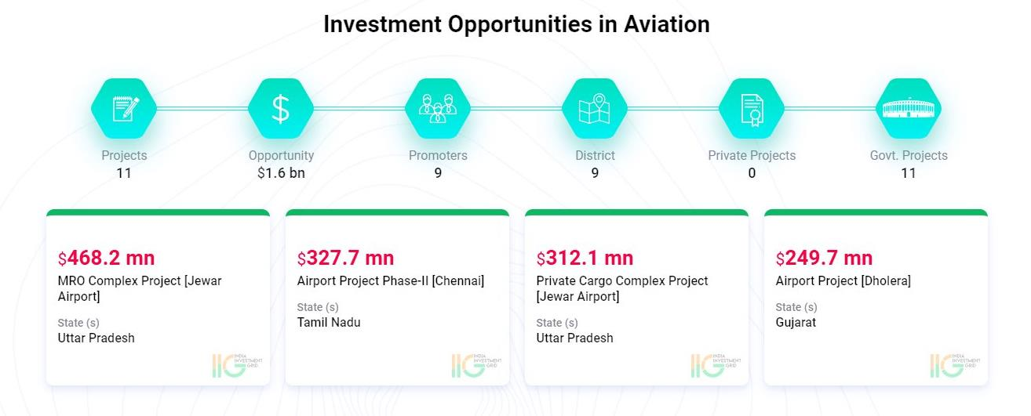
Growth Drivers : Aviation Industry
New Airports to be added to increase the number of operational airports to 250 by 2020
$120 bn investment in airport infrastructure planned

Slide 8
Growth Drivers : Port & Shipping Industry
The Government launched the ambitious Sagarmala Programme in March 2017, with the vision of port-led development and growth of logistics-intensive industries.
Under Sagarmala Programme, $ 123 bn would be invested across 415 projects across the following identified components:
Port Modernization and New Port Development
Port Connectivity Enhancement
Port-Linked Industrialization
Coastal Community Development
The projects identified under Sagarmala Programme is expected to mobilize over 61.6 bn of infrastructure investment

Slide 9
Growth Drivers : Healthcare
Infrastructure
$ 200 bn is expected to be spent on medical infrastructure by 2024
Health & wellness centre
150,000 centre with a budget of $ 1.8 bn will make the healthcare system more accessible
Rising disposable income
Growing middle-class and increased insurance penetration would lead to a steep rise in annual earnings of Indians

Slide 10
Growth Drivers
Tourism & Hospitality Industry
$230 bn
$424 bn
The industry’s total contribution to GDP stood at $ 230 bn in 2017 accounting for 9.4%
Is expected to further grow to $ 424 bn by 2027.

Slide 11
Growth Drivers: Tourism & Hospitality Industry
With growth in foreign tourist arrivals as well as domestic tourism, the construction of hotels and resorts is increasing across the country. Moreover, with rising disposable income, an increasing number of people are spending on luxury suites and other amenities for better vacation experience.
During the forecast period, around 50,000 new hotel rooms are expected to be constructed and added to the country’s hospitality industry due to increasing demand for hotels as well as luxury hotels, which is being backed by rising foreign as well as domestic tourism. On account of this anticipated growth in hospitality industry coupled with rising medical tourism in the country, demand for HVACs is expected to increase during forecast period..
With strong growth being witnessed in India’s construction market, demand for HVACs from major residential complexes, hotels, office spaces, amusement and recreation spaces is increasing, and this trend is anticipated to continue in the coming years.

Slide 12
Growth Drivers:Pharmaceutical Industry
The Pharmaceutical industry in India accounts for about 2.4% of the global Pharmaceutical industry in value terms. The turnover of the sector was estimated at $ 27.5 bn in 2015-16. The market is expected to expand at a CAGR of 12.8% over 2015–20 to reach $ 55 bn.

Slide 13
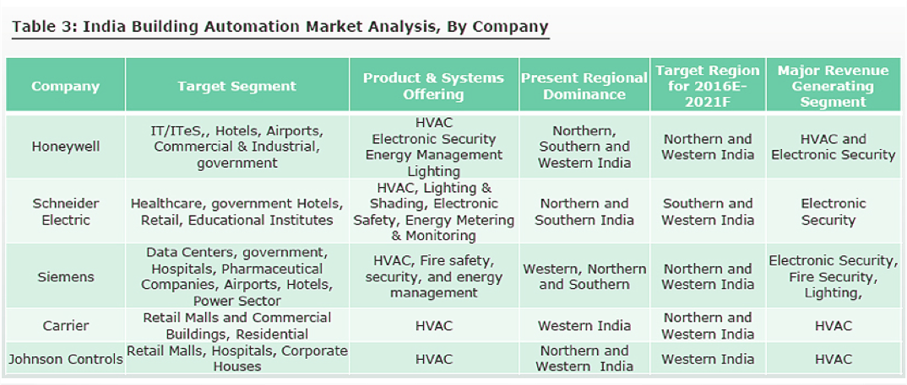
Growth Drivers: Building Automation & Controls System Market
One of the major factors driving building automation and control systems market in India is growing need to enhance the energy efficiency within the buildings. Convergence of IoT in building automation and rising technological advancements in wireless communication technology in India are further expected to fuel the country’s HVAC market.
The International Society of Automation (ISA) has developed a plan for promoting and improving energy efficiency through building automation and control systems. The company provides certification scheme and certification for energy performance for buildings. In India, the construction of buildings equipped with automated and control systems is increasing, which is resulting in growing adoption of HVAC systems.

Slide 14
HVAC
Market in India

Slide 15
PRESENTING THE INDIAN HVAC INDUSTRY
CAGR
9.86%
India HVAC Market to Grow at a CAGR of 9.86% during 2017 – 2022
India HVAC market is projected to exhibit a CAGR of 9.86%, in value terms, during 2017-2022
Growing infrastructure-based developments, technological advancements and increasing tourism activities are expected too positively influence India HVAC market over the next five years. Moreover, extreme climatic conditions, rising disposable income, growing construction activities in both commercial and residential sectors, coupled with various government initiatives aimed at improving energy efficiency are some of the other major factors expected to aid India HVAC market during forecast period
India Building Automation Market to record 12% CAGR during 2017 - 2023
Direct Expansion HVAC market in India in 2016 accounted for USD3,344.56 Million, and the same trend is expected to continue over the next five years as well.
India HVAC Market Size , By Value, 2017E & 2022F
17

Slide 16
THE INDIAN HVAC INDUSTRY
North region dominated India HVAC market with a revenue share of 39.29% in 2016, with Delhi-NCR playing a vital role in growing demand for HVAC systems. In cities such as Gurugram, Noida, Greater Noida and Chandigarh, rapid infrastructure development activities are taking place, and registering huge demand for HVAC units.

Slide 17
India HVAC Market Size
By Value (USD Million), By Volume (Thousand Unit), 2012–2022F
CAGR 2012-2016
By Value: 7,25%
By Volume: 4.57%
CAGR 2017E-2022F
By Value: 9.86%
By Volume: 6.46%
By Value (USD Million)
By Volume (Thousand Unit)

Slide 18
India HVAC Market Size
In India, the market for direct expansion HVAC system grew at a CAGR of 7.55%, in value terms, during 2012-2016, on account of easy installation, which reduces the overall cost of the system. Moreover, the revenue share of direct expansion HVAC system in India HVAC market is forecast to increase from 74.60% in 2016 to 77.38% by 2022.
Commercial sector predominantly include hospitality, healthcare institutions, IT & ITeS, etc. Surging medical tourism and expanding IT & ITeS sector are driving demand for HVAC systems in the country. Thus, the value share of commercial sector in India HVAC market is projected to increase from 27.87% in 2016 to 28.75% by 2022.
India HVAC Market Share, By Type, By Value, 2012-2022F
Direct Expansion System
Central HVAC System

Slide 19
Founded
ISHRAE was founded in 1981 at New Delhi by a group of eminent HVAC&R professionals.
Board
It is led by a team of elected officers, who are members of the Society, working on a voluntary basis, and collectively called the Board of Governors.
Members
Operation
ISHRAE today has more than 12,000 HVAC&R professionals as members and 7,500 Student-members.
ISHRAE operates from 41 Chapters and sub Chapters spread all over India, with HQ in Delhi.
ISHRAE in Policy Making
ISHRAE works closely with the Bureau of Energy Efficiency (BEE) & Bureau of Indian Standards (BIS) in making codes and standards.

Slide 20
Programs
Preparing students to be the leaders of tomorrow
Every year, ISHRAE organizes many programs across the country which includes:
Expositions l Conferences l Technical Seminars l Technical Presentation l Workshops l Product Presentation l Lectures l Panel Discussions
ISHRAE has many student members which are spread across students chapters at many colleges and technical institutes through out the country. They gain valuable and useable knowledge and experience derived from specific activities designed for them, which includes
Technical Seminars | Industrial Site Visits | Research Projects | Design competition - NSDC | Placement Program – Job Junction | Quiz – aQuest
ISHRAE works aggressively to raise awareness and advocates for the strengthening of Science, Technology, Engineering & Math (STEM) related programs at all levels among students.

Slide 21
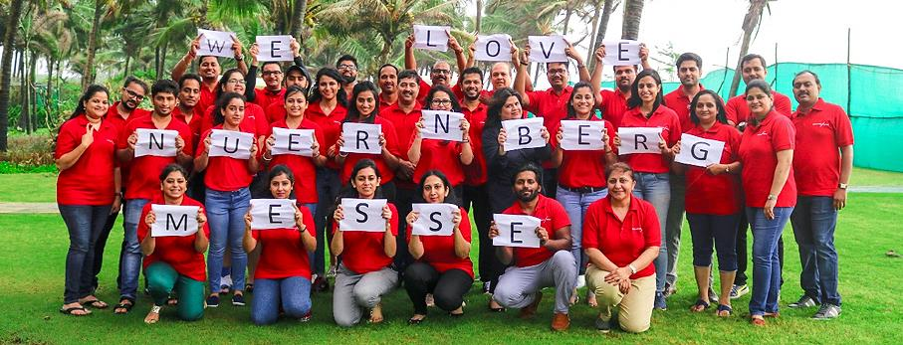
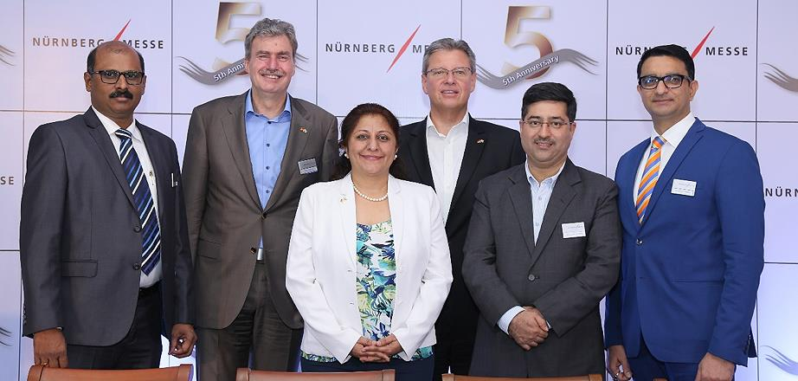
NürnbergMesse India
NürnbergMesse is one of the 15 largest exhibition companies in the world. Its portfolio covers over 120 national and international exhibitions and congresses.
Every year over 30,000 exhibitors (international share: 41 percent) and upto 1.4 million visitors (international share of trade visitors: 24 percent) participate in events of the NürnbergMesse Group.
The group is present with subsidiaries in China, North America, Brazil, Italy and India. The group also has a network of about 50 representatives operating in over 100 countries.
The NürnbergMesse Group entered the Indian Market in 2013 as part of its corporate strategy by launching shows on niche and theme

Slide 22
Portfolio of NürnbergMesse India

